Slide 1
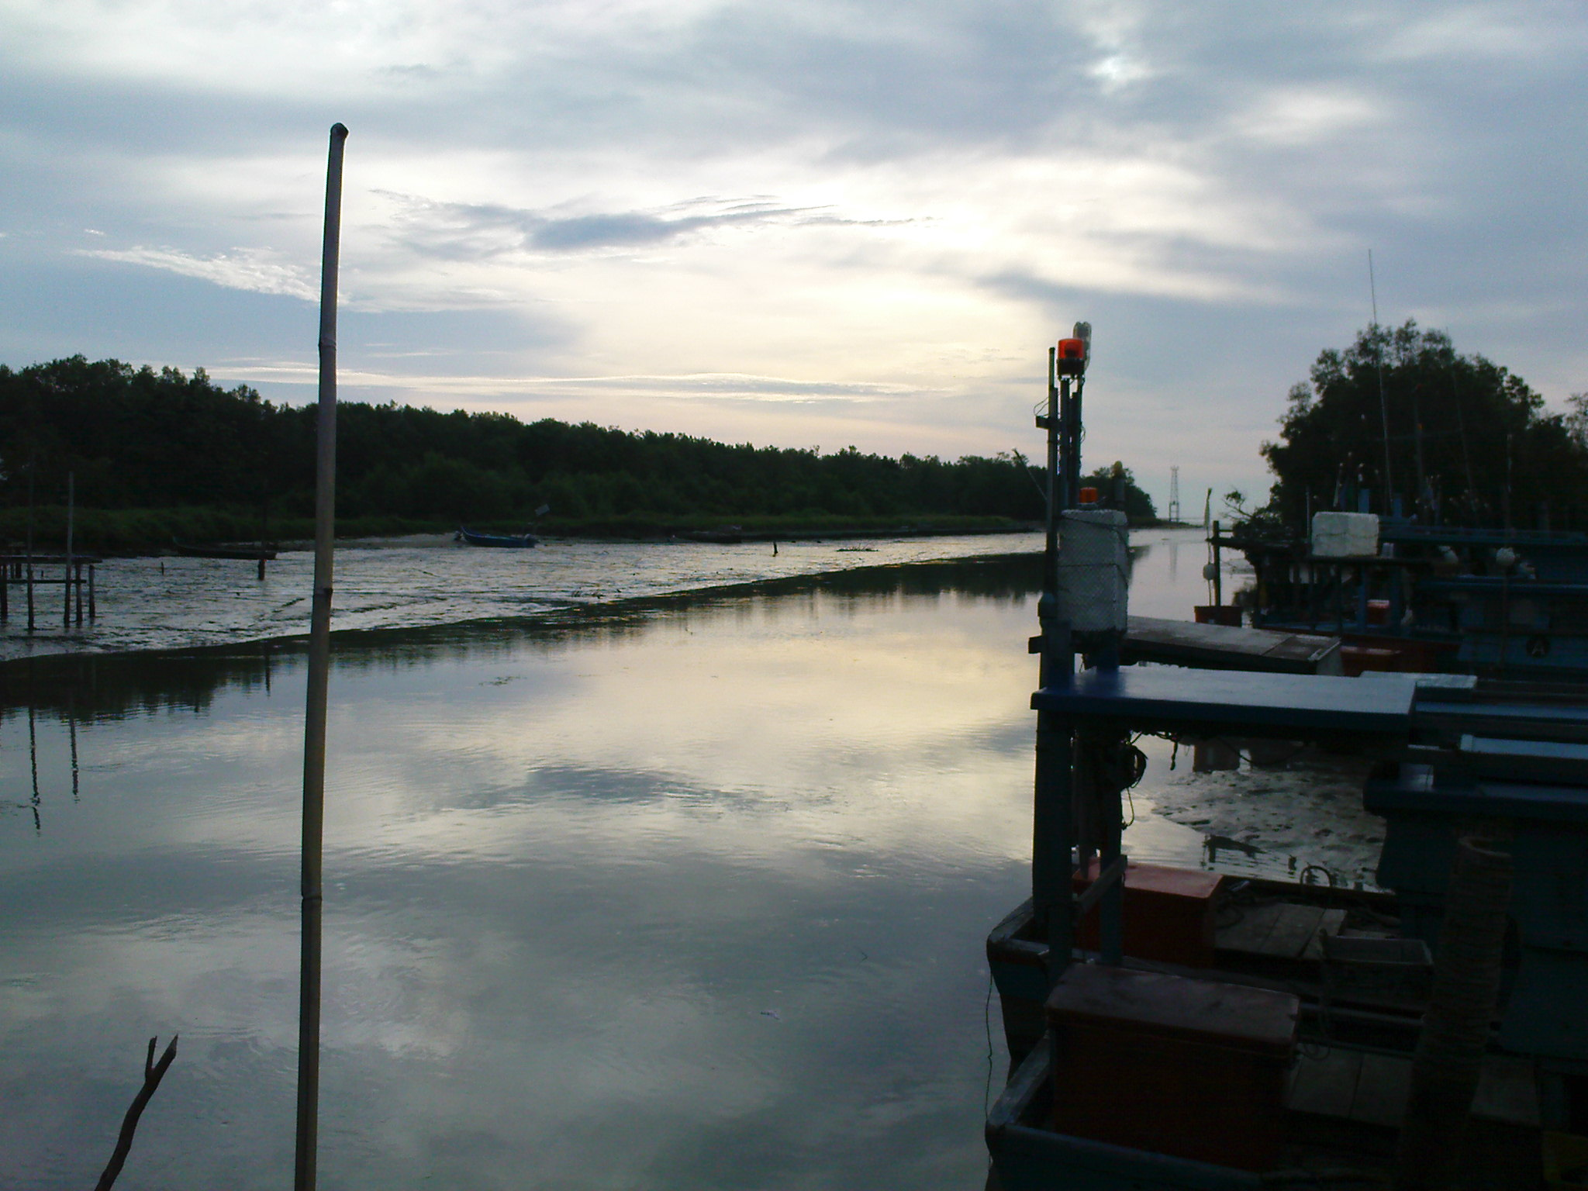
MY CONTRIBUTION IN THE CONSTRUCTION FOR REAL IN BALIK PULAU, PENANG.
LIM LAI SIM
103692
QUANTITY SURVEYING

Slide 2
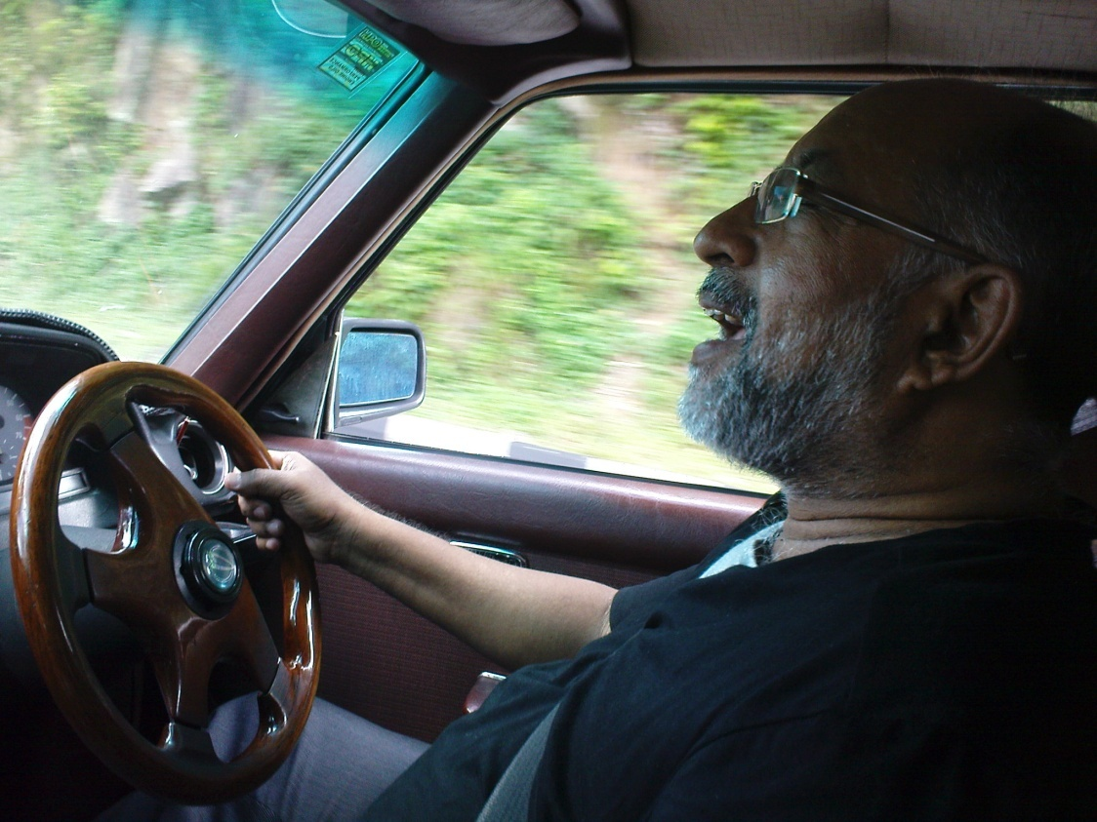
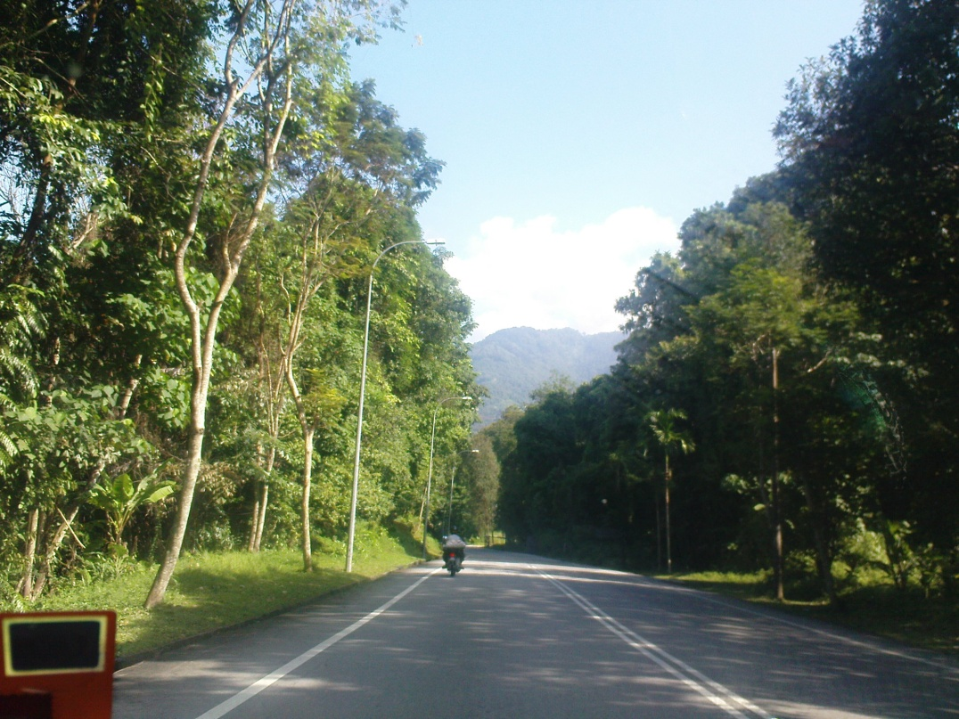
On 2nd of Oct , we were heading to Kampung Sungai Pinang, Balik Pulau, Penang at about 9a.m.

Slide 3
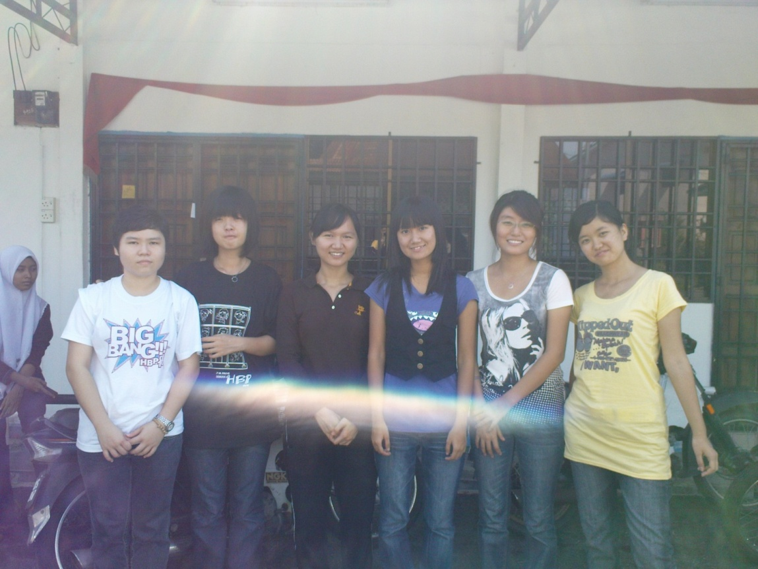
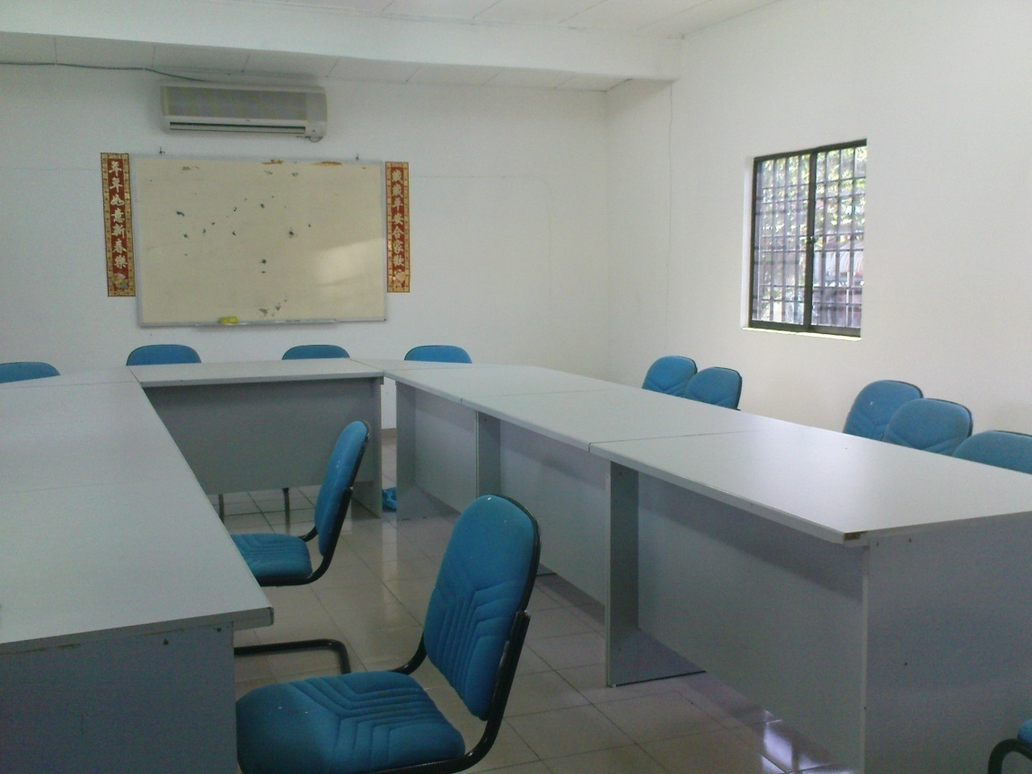
We arrived at 10.10 a.m. and we gathered at the Main Office in Kampung Sungai Pinang.

Slide 4
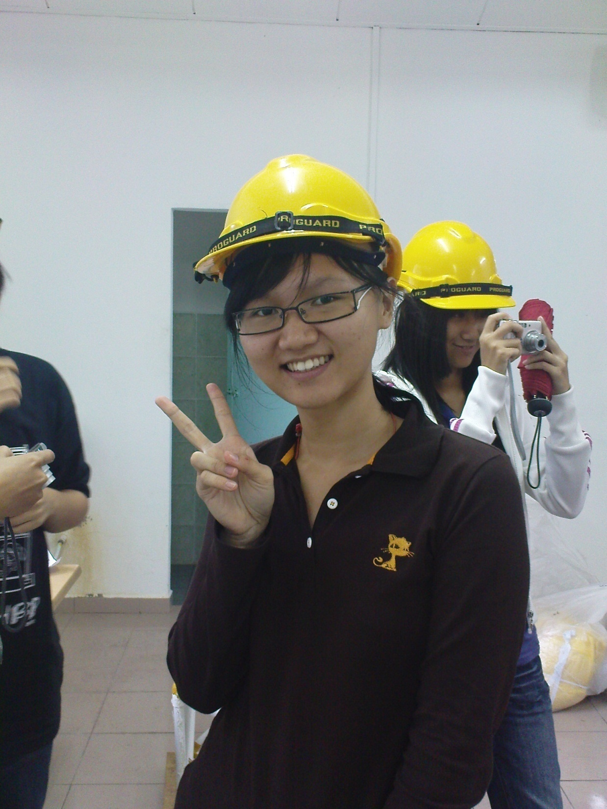
All of us have to wear safety helmet so that the villager recognized us .

Slide 5
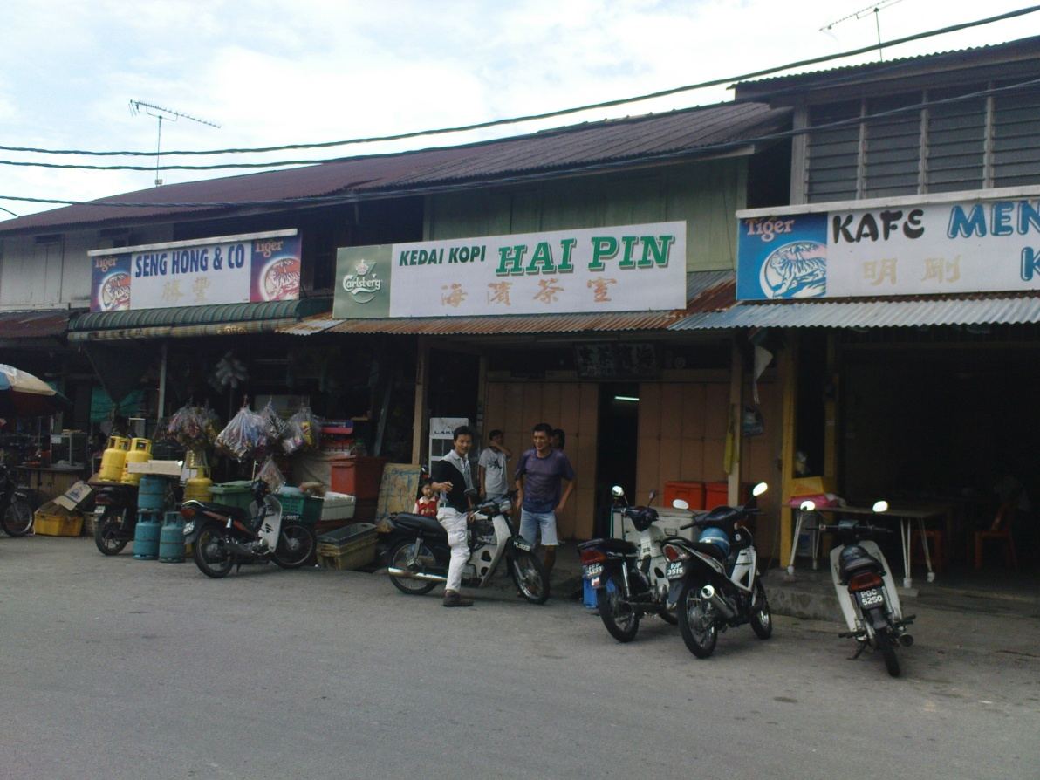
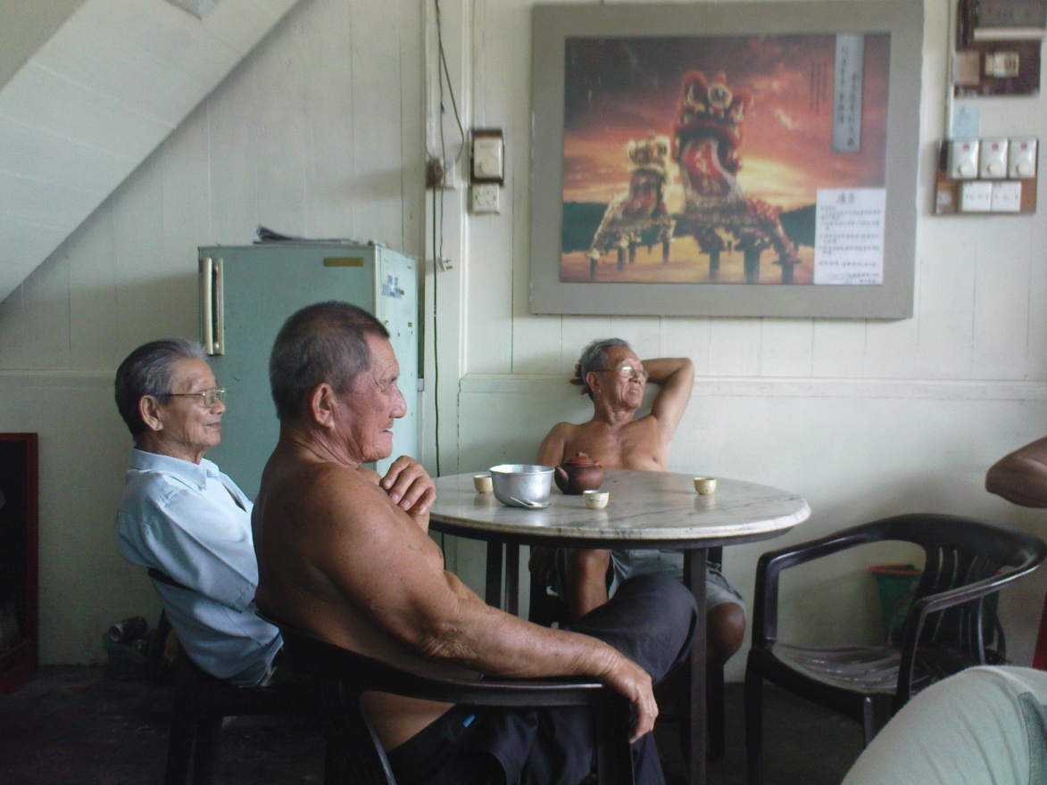
We were seeing around to understand the current situation for planning the next action to be done to help the community.

Slide 6
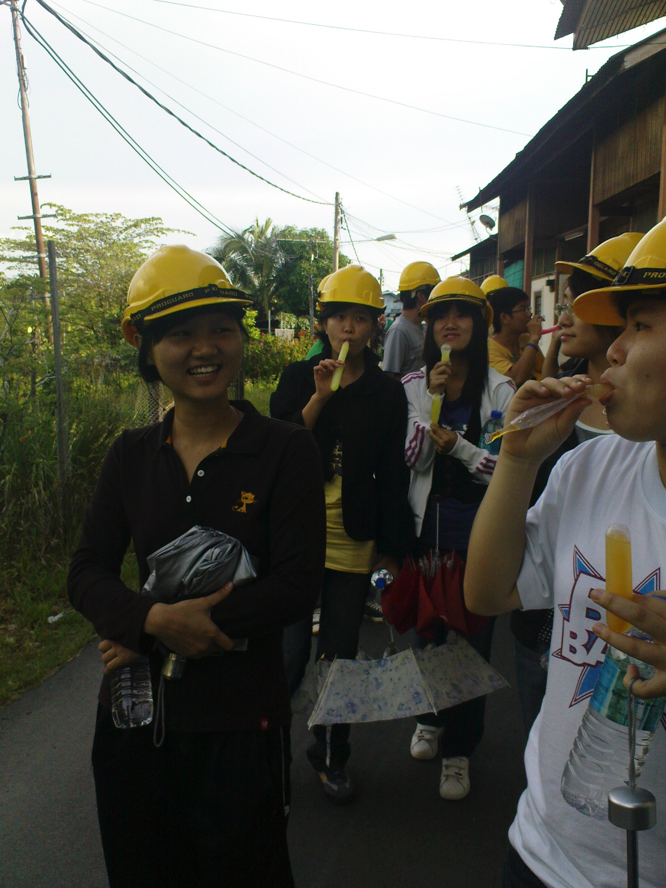
We were walking around to collect discarded materials to be used for the construction.

Slide 7
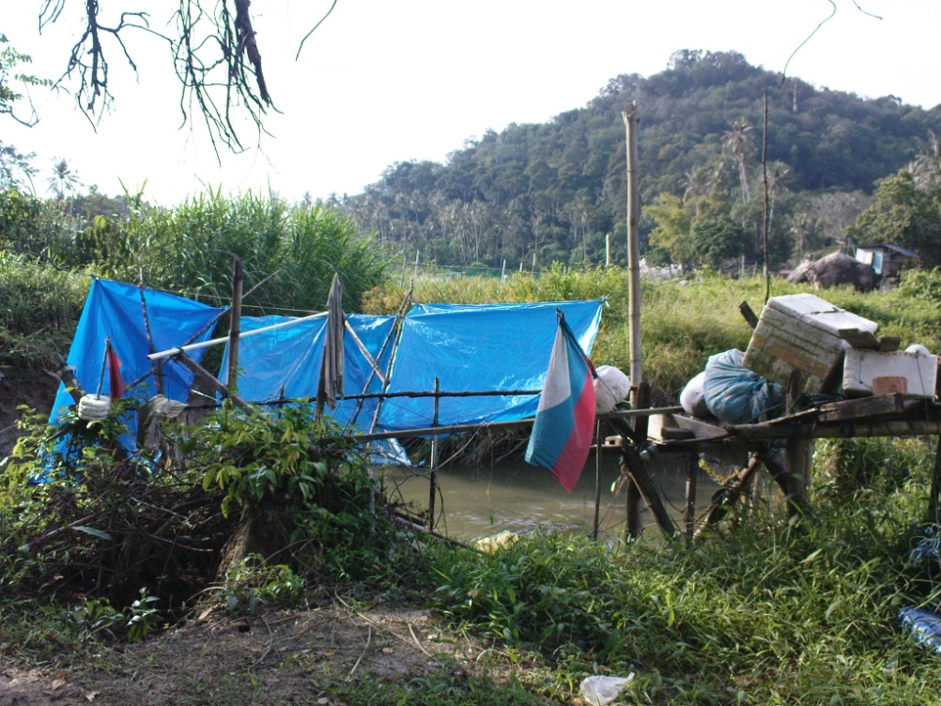
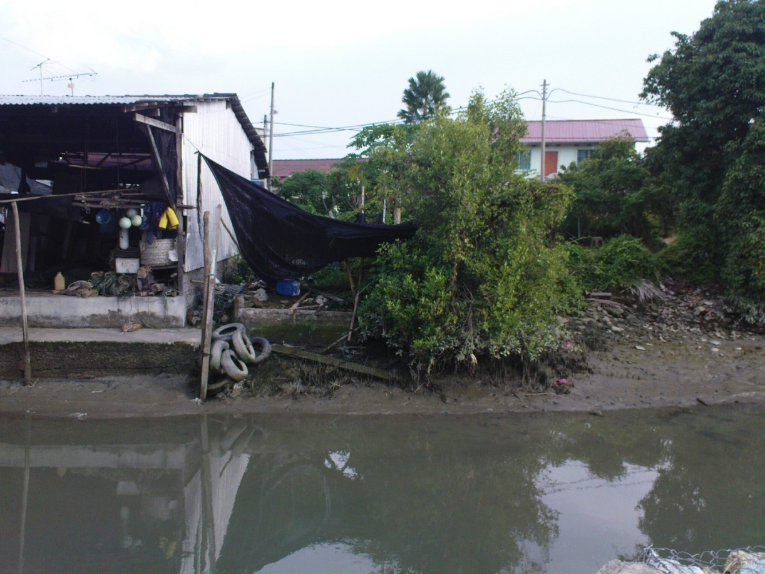
Those were the materials that we discovered.

Slide 8
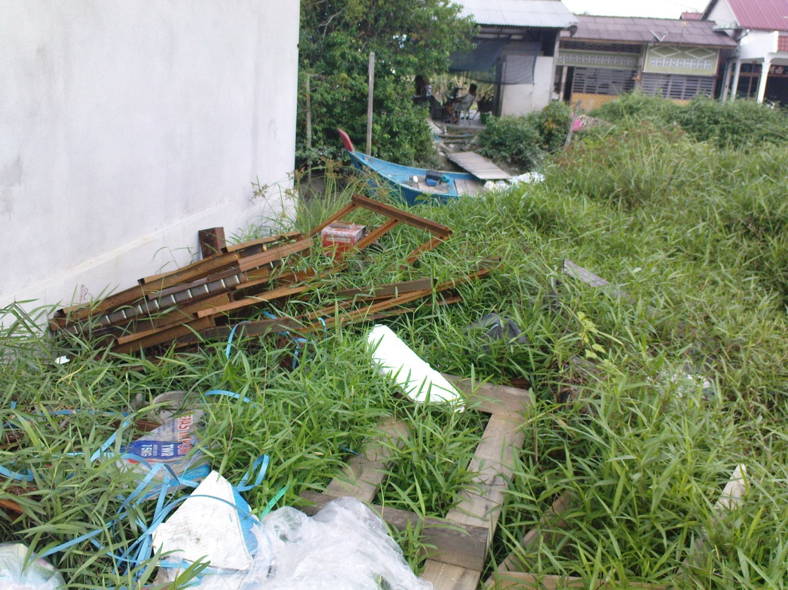
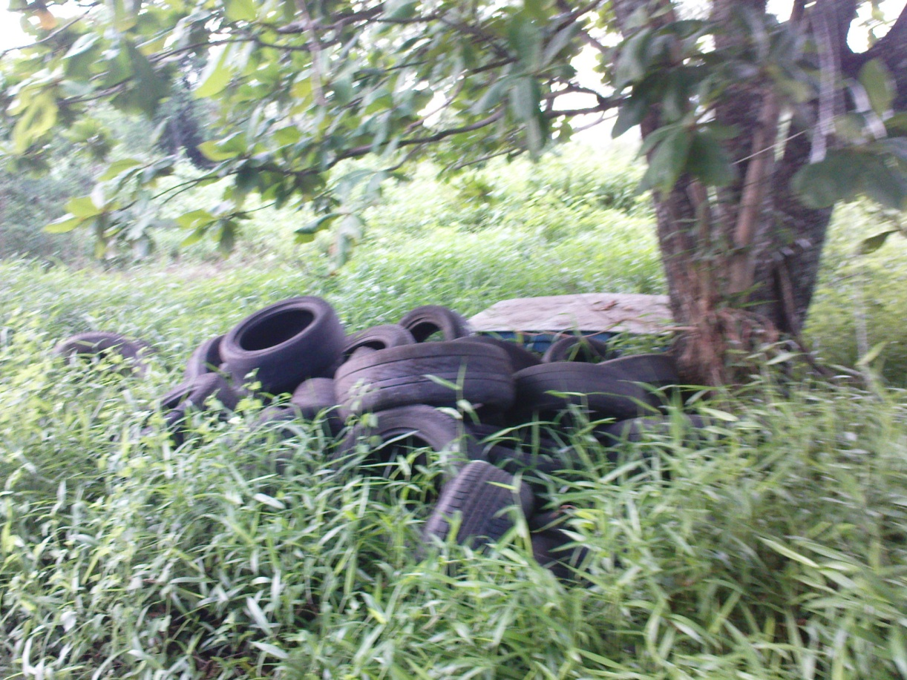

Slide 9
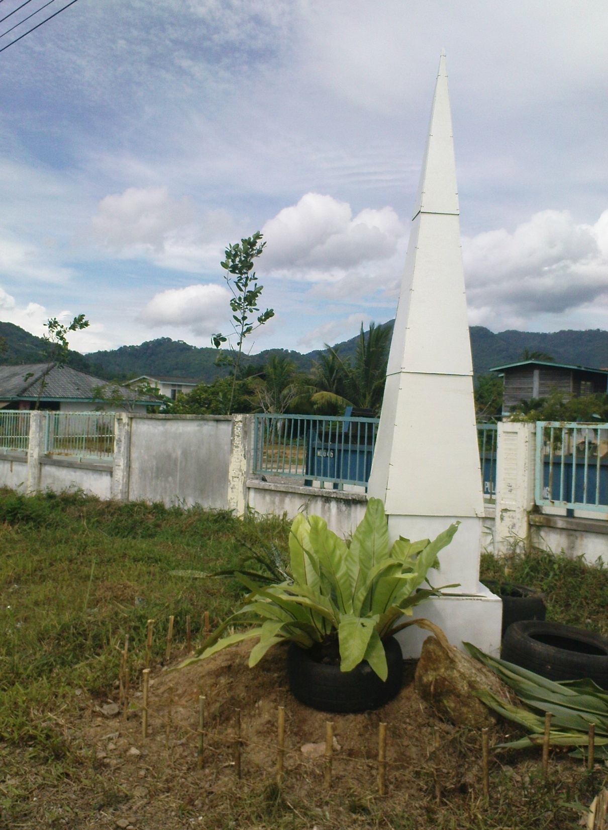
Obelisk
Plants
Tyres
Bamboos

Slide 10
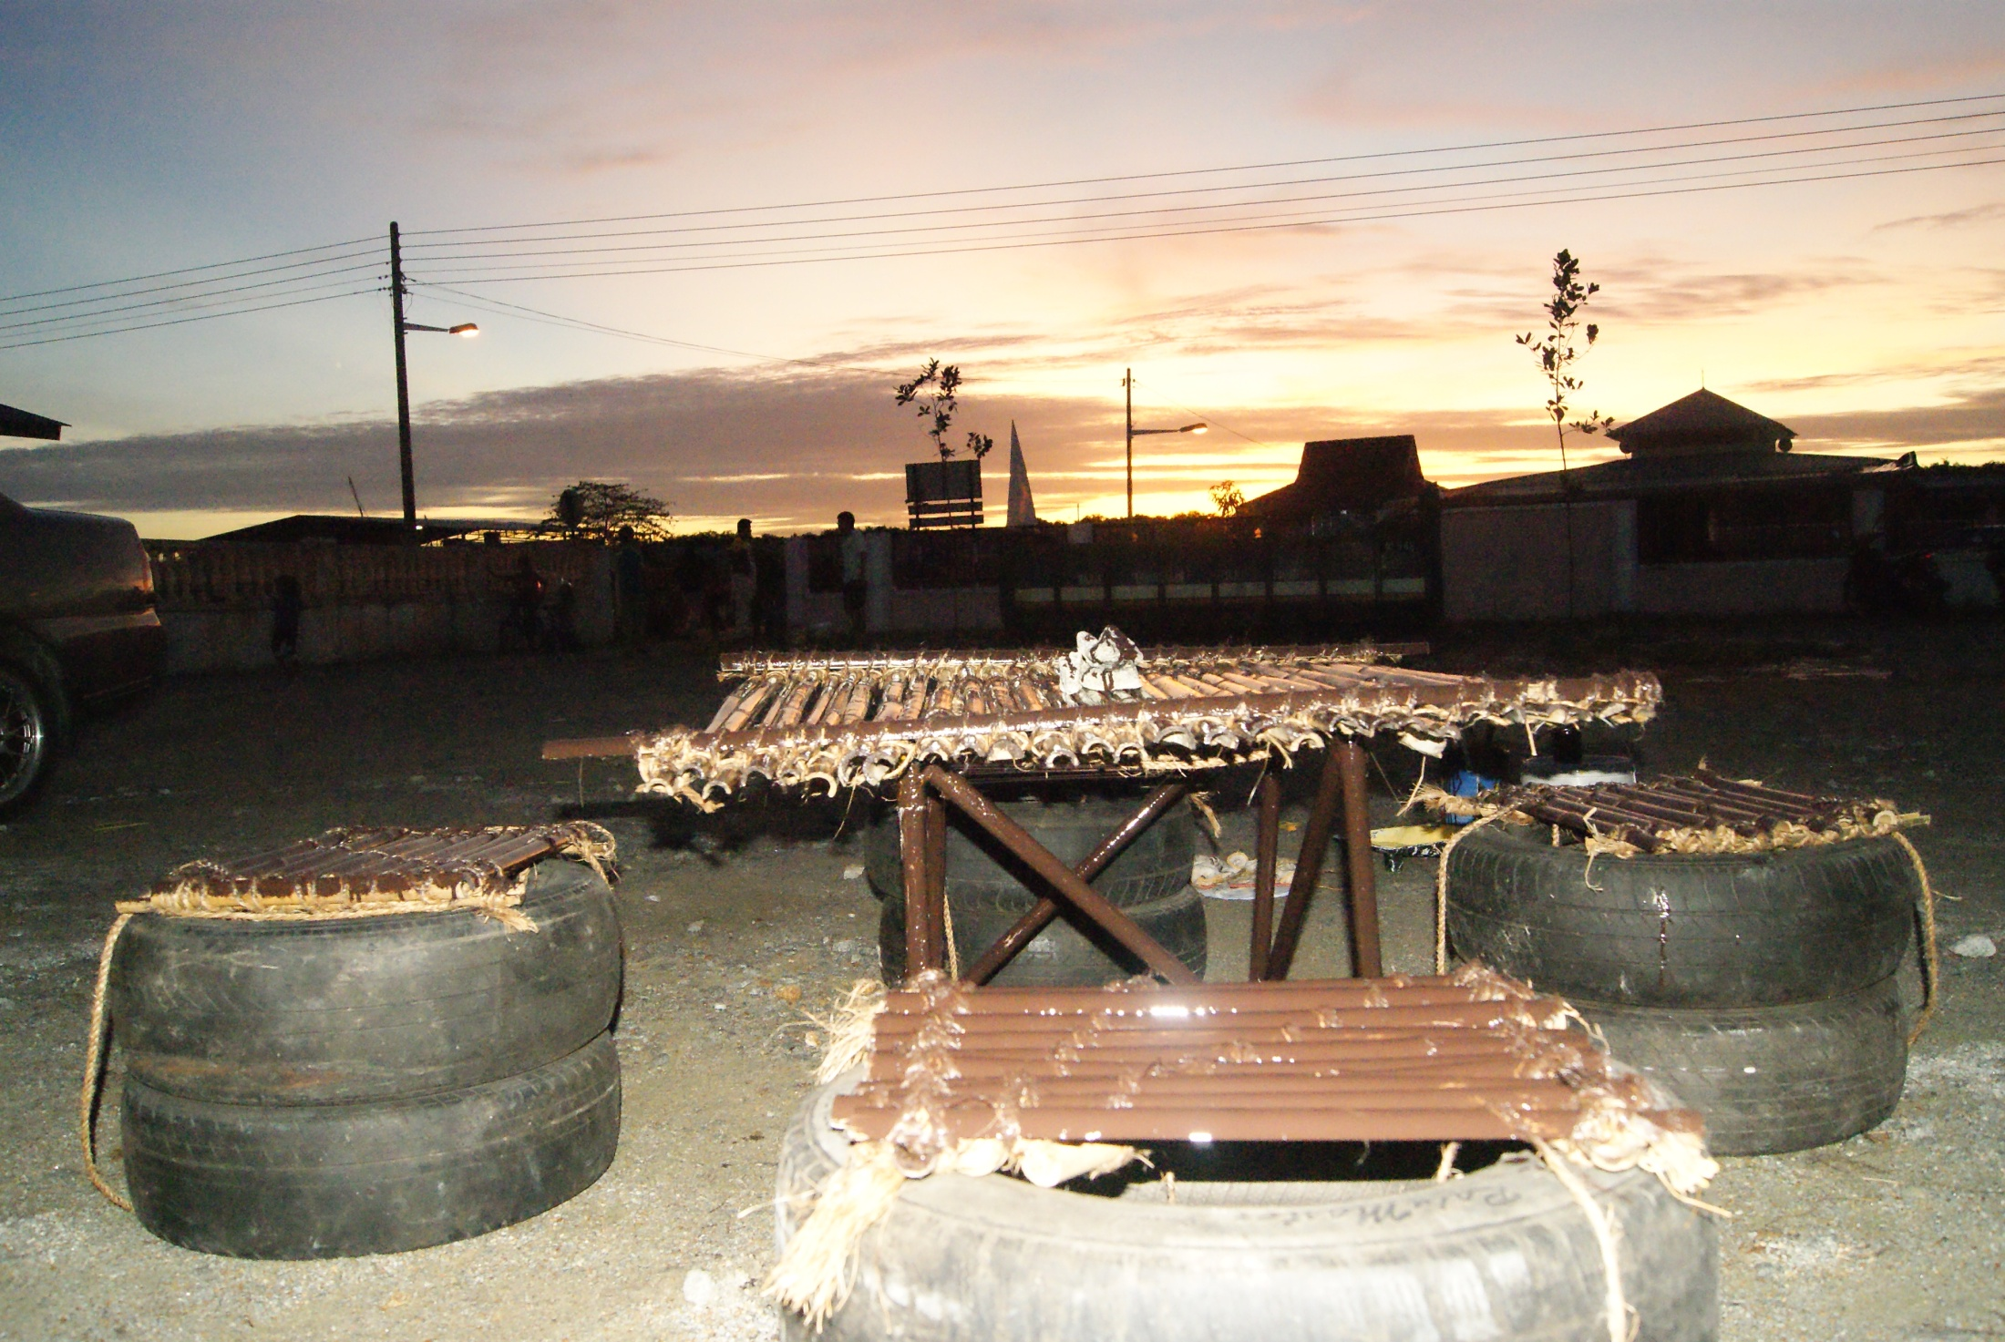
Bamboos
Tyres

Slide 11
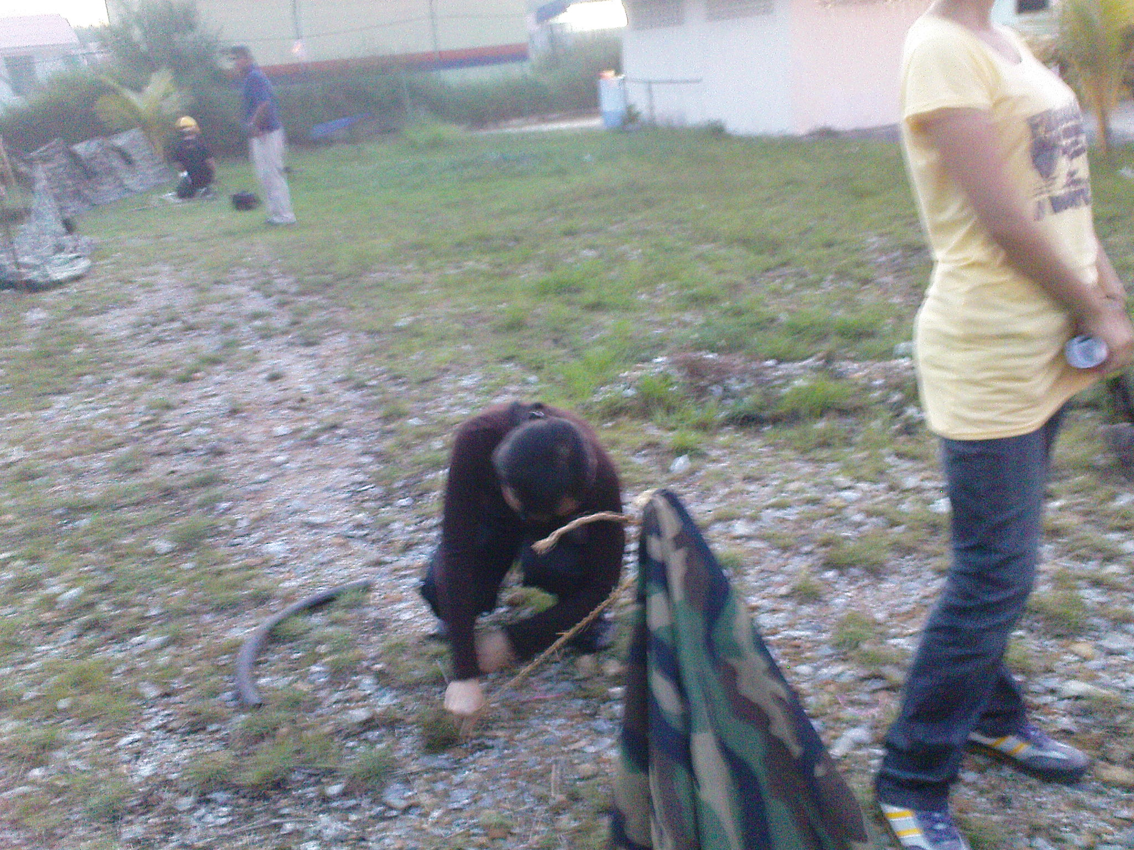
Setting up tent

Slide 12
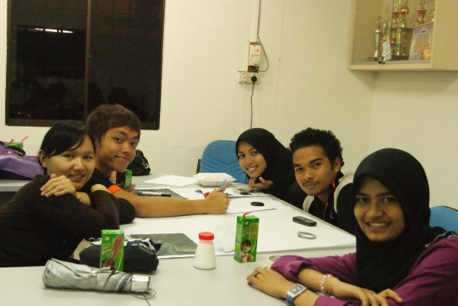
Having our group discussion for the concrete fence painting

Slide 13
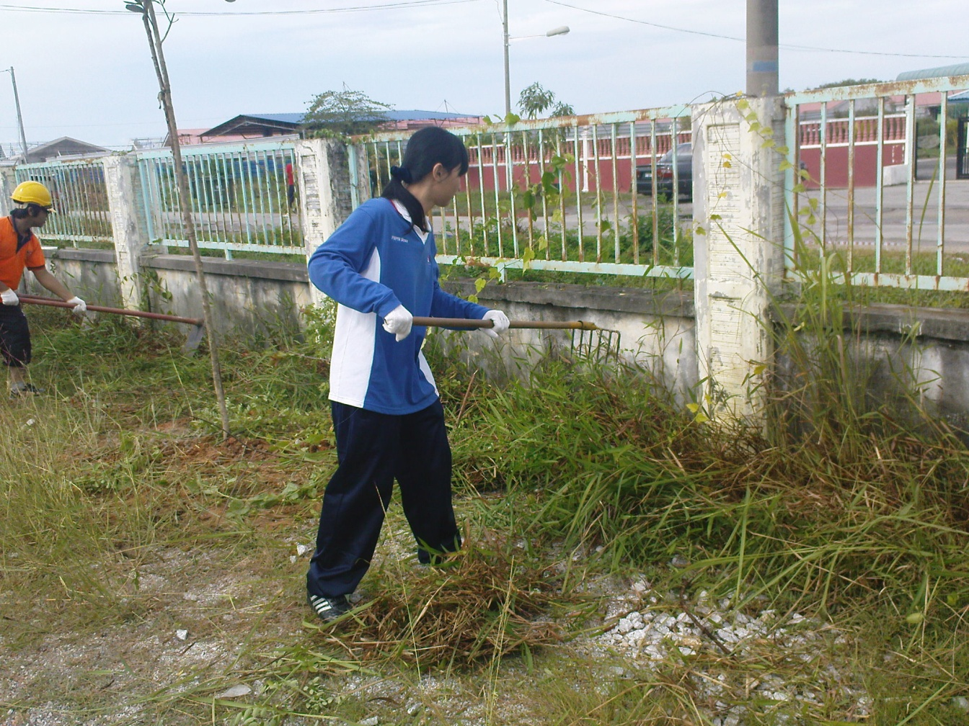
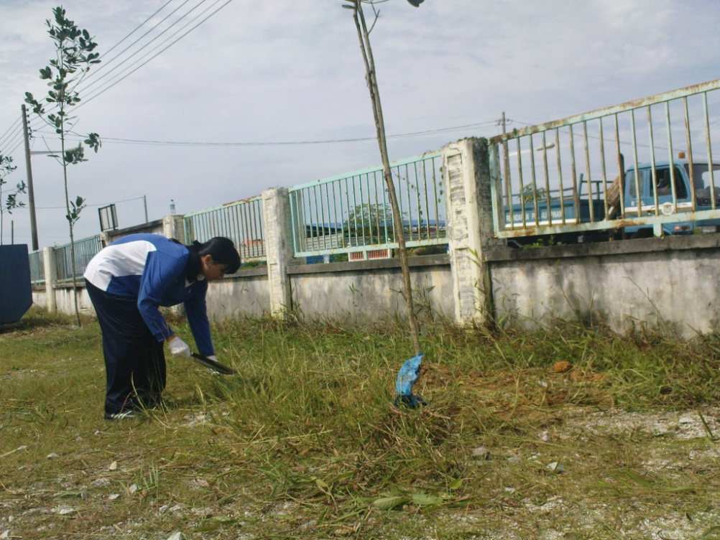
Clearing the wild grass before started to paint.

Slide 14
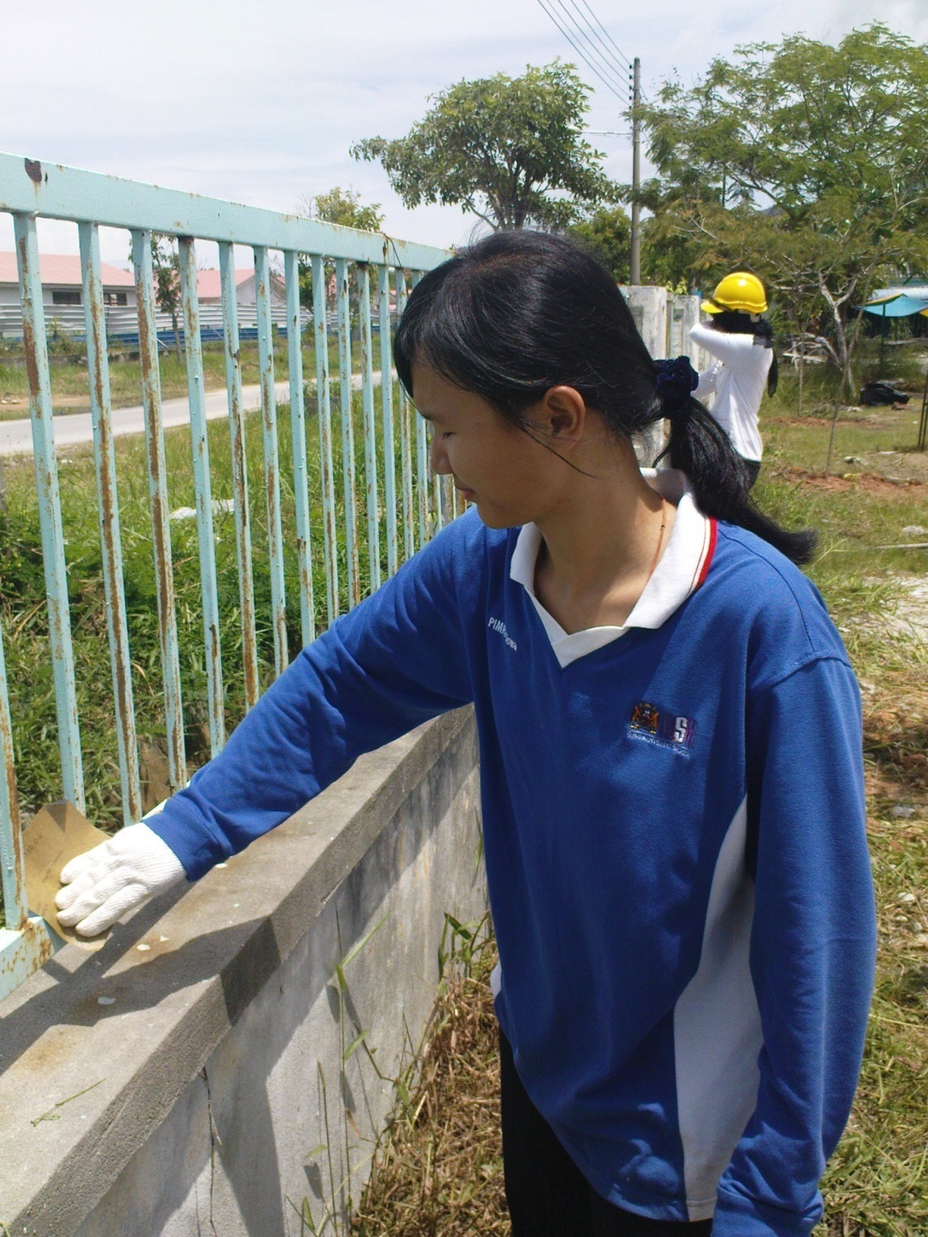
Cleaning the wall surface.

Slide 15
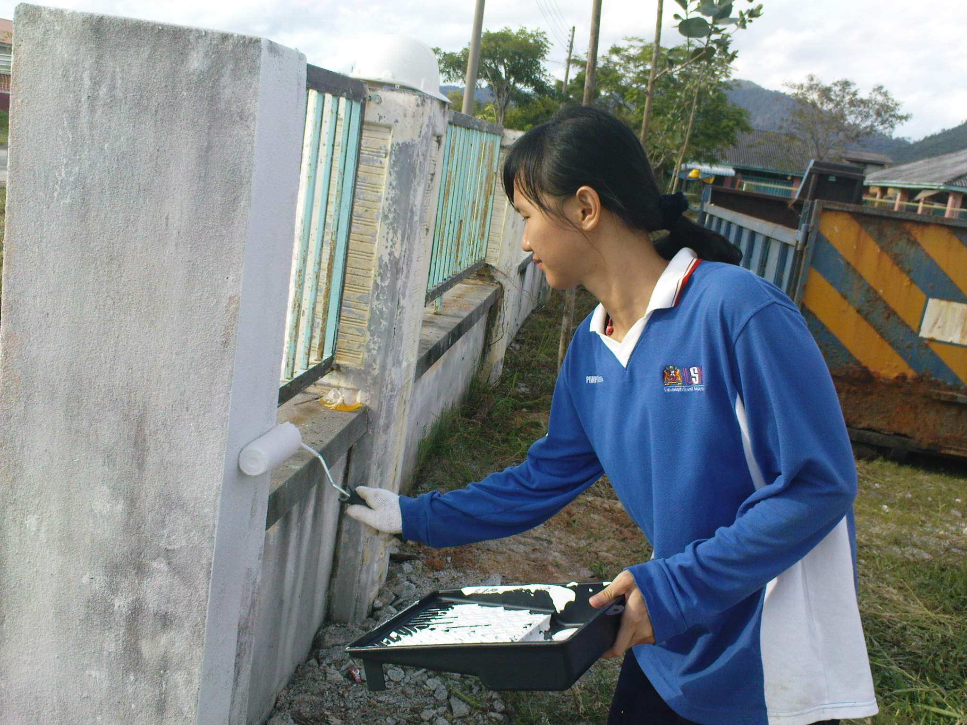
Applying 1 coat of undercoat and 2 coats of finishing

Slide 16
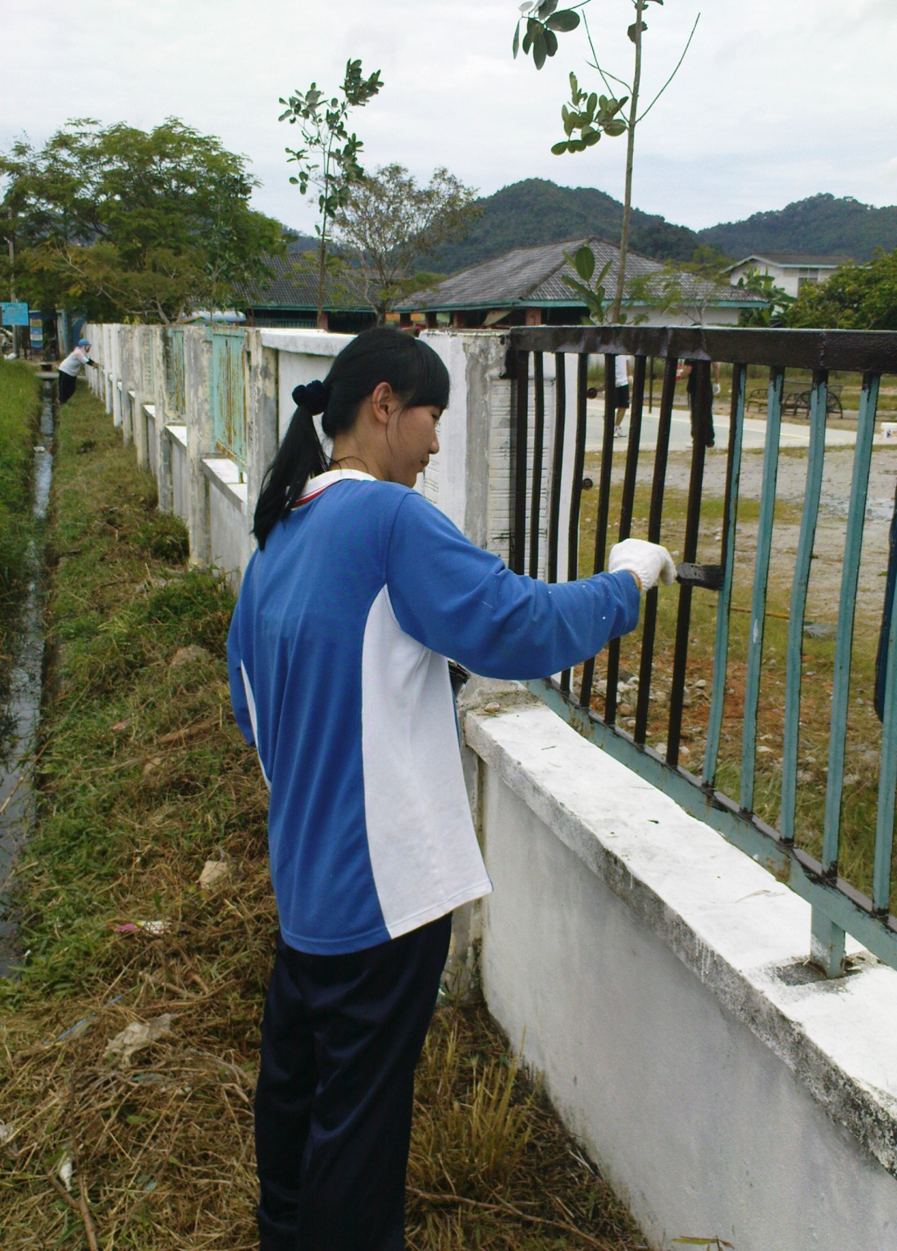
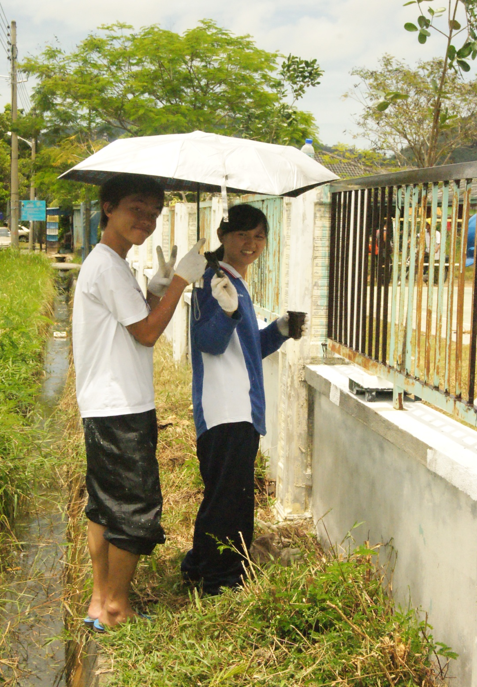
Painting.

Slide 17
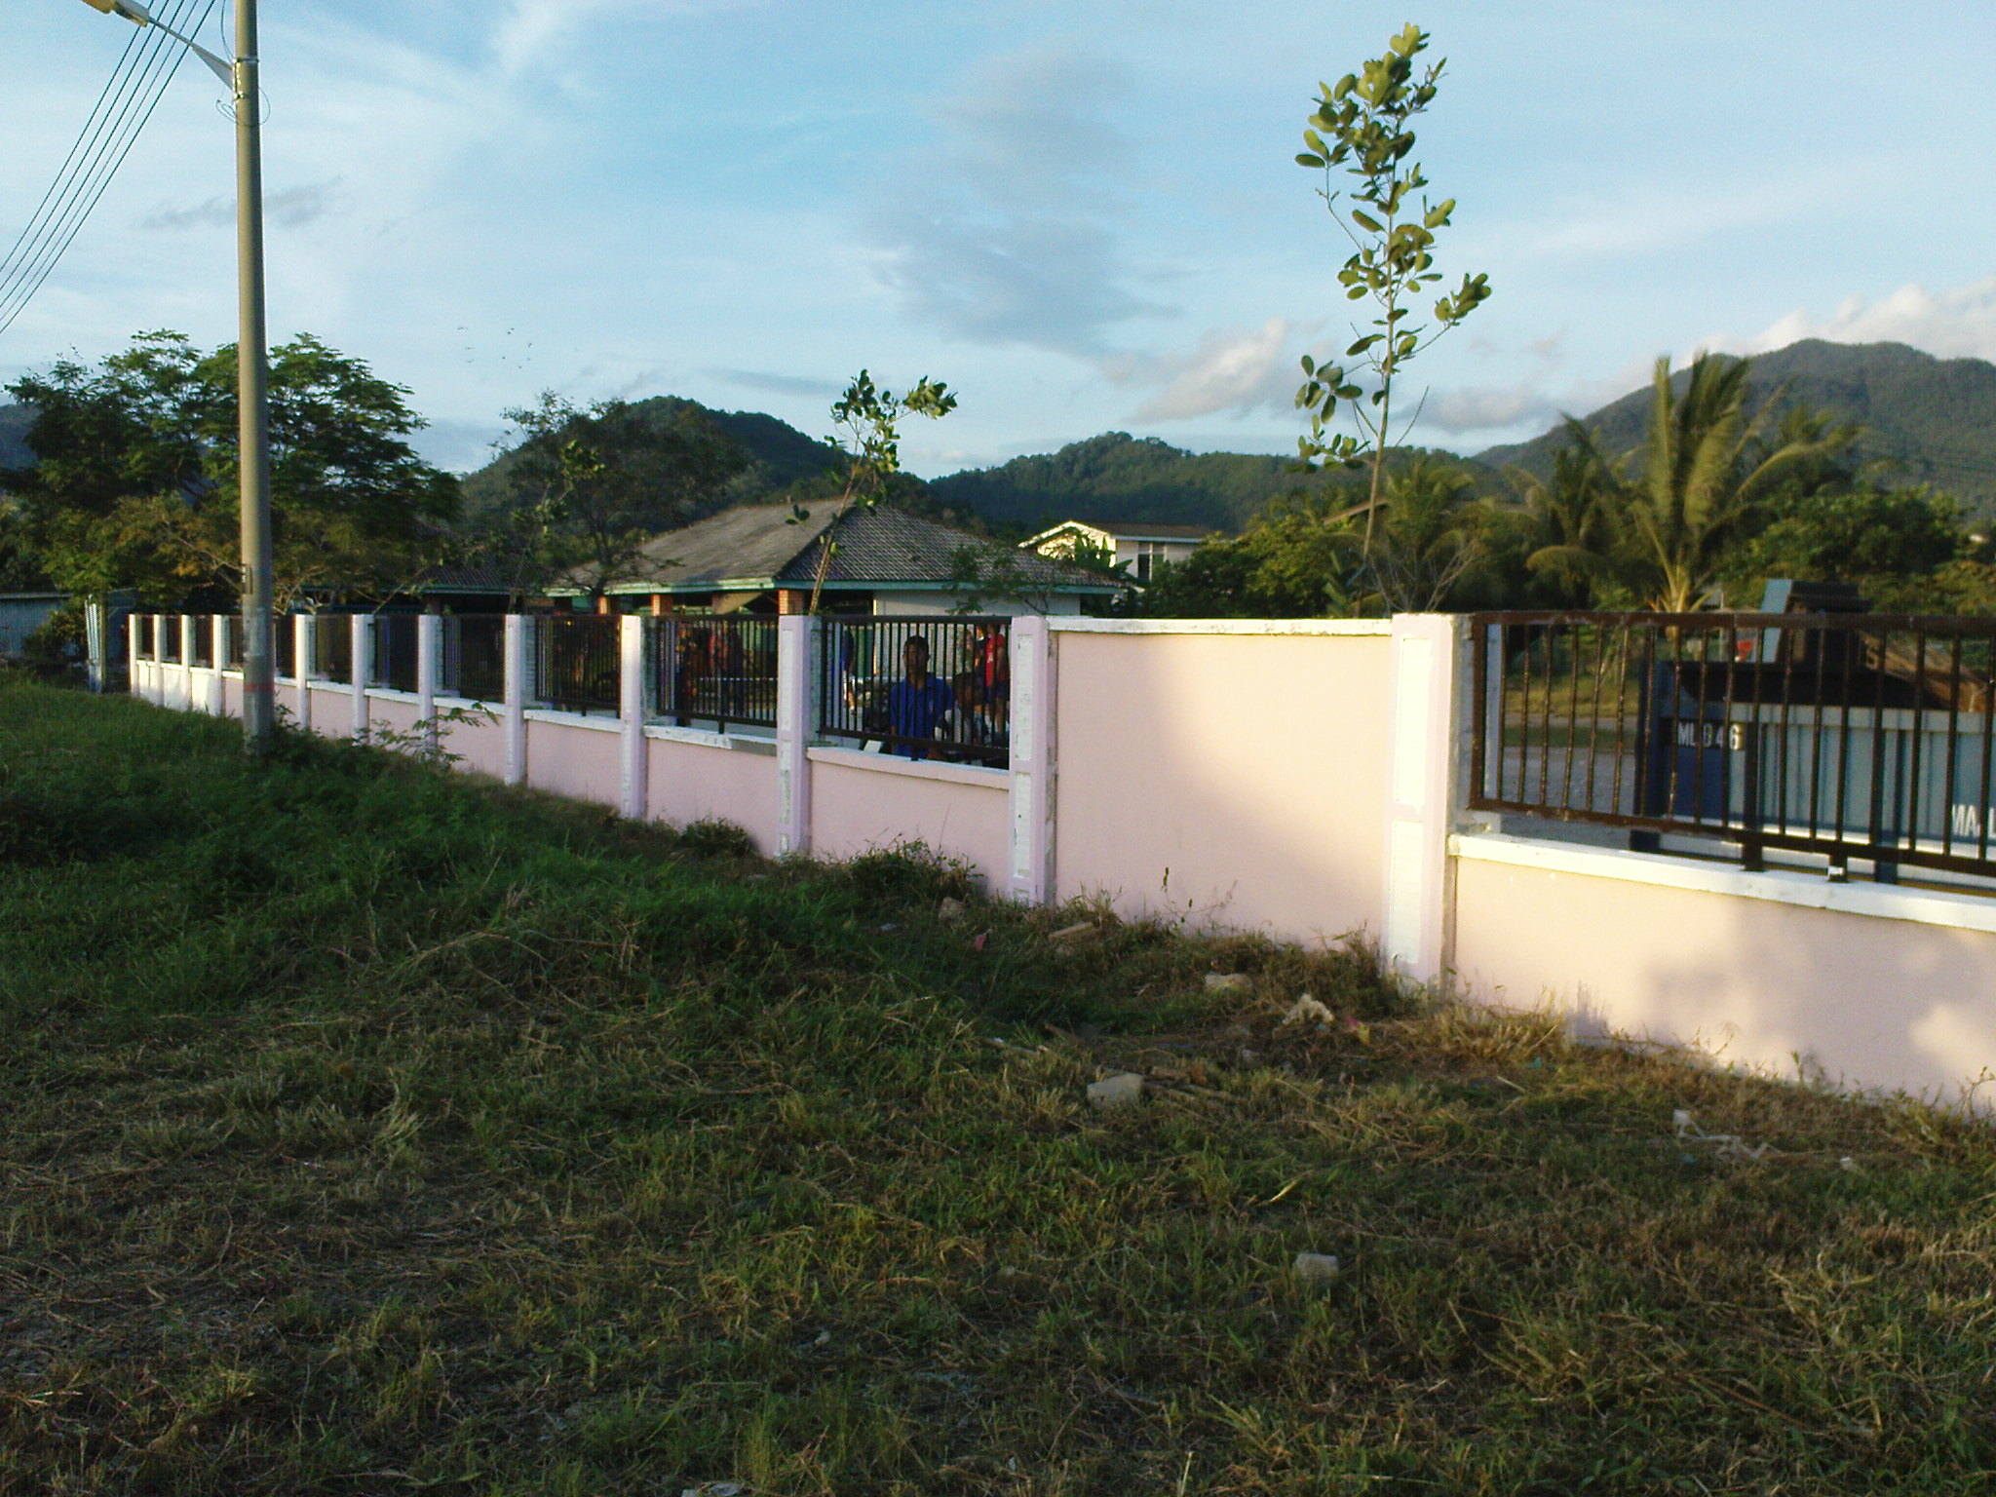
It’s done.

Slide 18
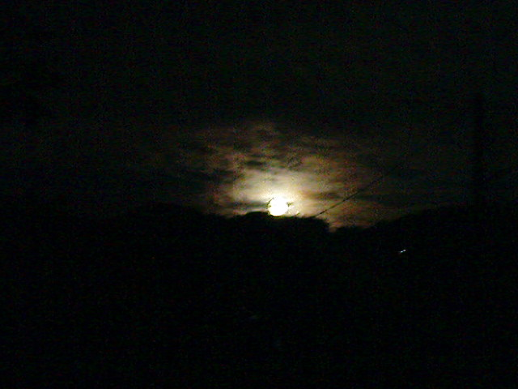
THE END
THANK YOU

